Slide 1

IBM Data Science Capstone Project
A Cup of Joe in NYC
Christopher Gibbons
2020-02-25

Slide 2
Introduction
This is the report for the IBM Data Science Professional Certificate capstone project.
We have all seen countless failed restaurants, coffee shops, and the like in our travels. While there are many factors that go into a successful business, if there are too many well-established competitors a new establishment will fail to draw business and will not stand a chance. In this project we identify areas around New York City that are deficient in coffee to find low competition areas a coffeeshop might thrive in.
The target audience is those who wish to identify a good location to start a coffeeshop business.

Slide 3
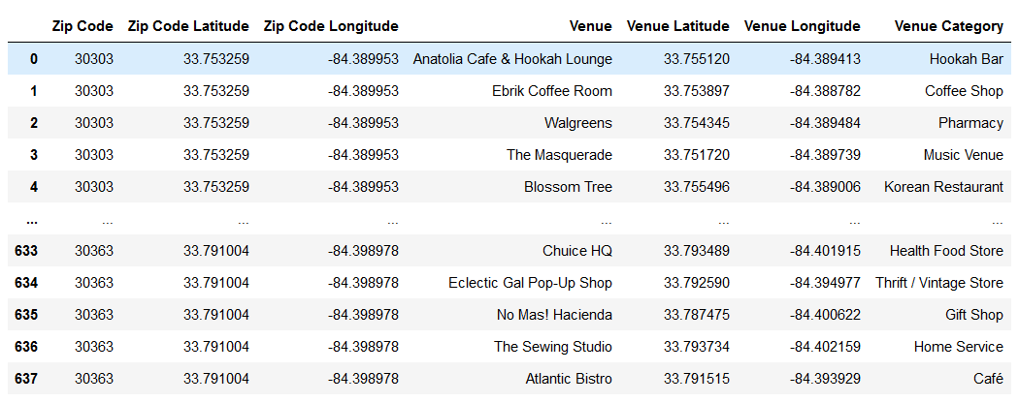
Data
As mandated by the guidelines given for the assignment, Foursquare was the primary source of data.

Slide 4
Methodology
First, establishments were grouped and K-Means was done to further group the data. This was done to improve the significance of each column, as many of the raw categories were empty for the vast majority of locations in some cases.

Slide 5
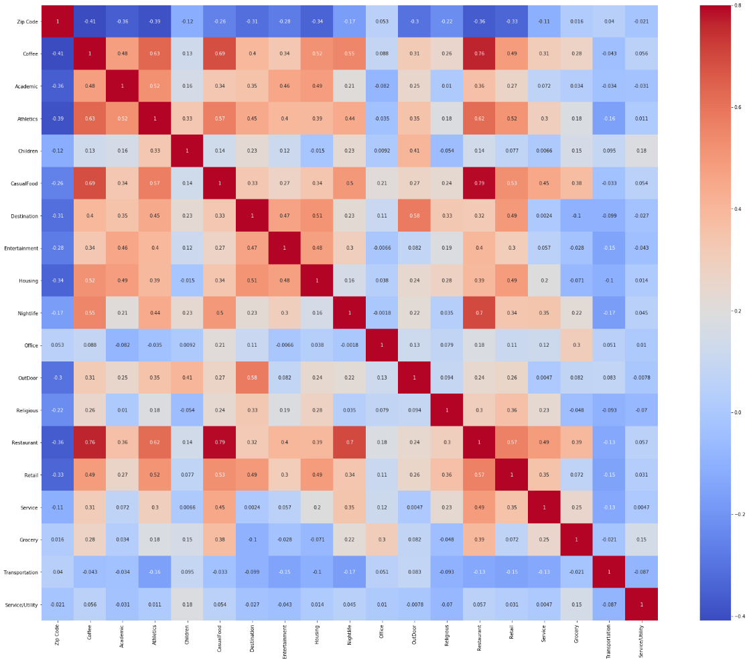
Methodology
Then, a correlation heatmap was used to inspect the relationship between variables and to ensure we can proceed with our analysis.

Slide 6
Methodology
A range of models was then attempted.
Of them models, simple ridge regression was found to have the strongest R2 on cross-validation.
The scikit-learn model’s built-in scoring system was used, along with separate validation data, to judge the models.

Slide 7
Results
Initially, it was hoped to use Atlanta, the author’s home city, as a choice of location. However, the Foursquare data for Atlanta was found to be too sparse to be useful. The data for New York was, as anticipated, much richer and perfectly suitable for the task after grouping.

Slide 8
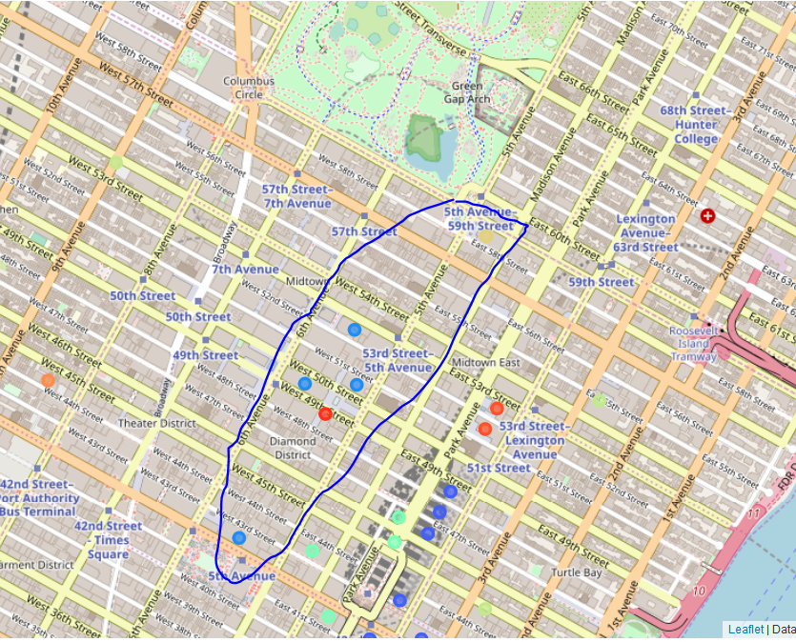
Results
The three most coffee-deficient zones were found to be clustered together in and around the Diamond District. The area looks walkable at a glance and is well positioned by Central Park. There does not appear to be a good reason for there to be few coffee shops in the area.

Slide 9
Conclusion
My recommendation would be to look at the diamond district in Manhattan as a possible site for a new shop.
Other factors, such as walkability and property values are important considerations and could be added to a follow-up project.
The results herein are insufficient to justify a business decision on their own but may represent a solid place to start from in the search for locations for a new business.

